Slide 1

Progress Presentation PATIENT MANAGEMENT SYSTEM 2023-24 Group No. GB31

Slide 2
Team Members
YASHWANT SINGH VISHAL KUMAR VIPIN SHARMA UJJAWAL TYAGI
SUPERVISED BY:
Dr. SANGEETA ARORA

Slide 3
INTRODUCTION
Hospitals are the essential part of our lives which provides us with the best medical facilities for various sickness, it may be due to the change in climatic conditions, stress (emotional trauma) etc. It is necessary for the hospital to keep track of all activities and records day in and day out of its patient, doctors, nurses and other staffs that keeps the hospital in its operation
Patient Management System (PMS) is a comprehensive web-based application designed to streamline healthcare facilities and enhance patient management. This project aims to provide a centralized platform that allows doctors, patients, and clinic administrators to efficiently manage medical records, appointments, and communication.
The primary objective of the Patient Management System is to improve the patient experience, optimize healthcare provider efficiency, and maintain accurate and secure medical records. By leveraging technology, the system simplifies the management of healthcare facilities and enhances the overall quality of care provided.

Slide 4
Project Modules
Completed Modules:
1. Home Page
2. Login Page (Doctor & Patient)
3. Doctor/Patient Register Page
4. Patients Appointment Booking Page
5. Verification Account Page
6. Contact us
7.About us

Slide 5
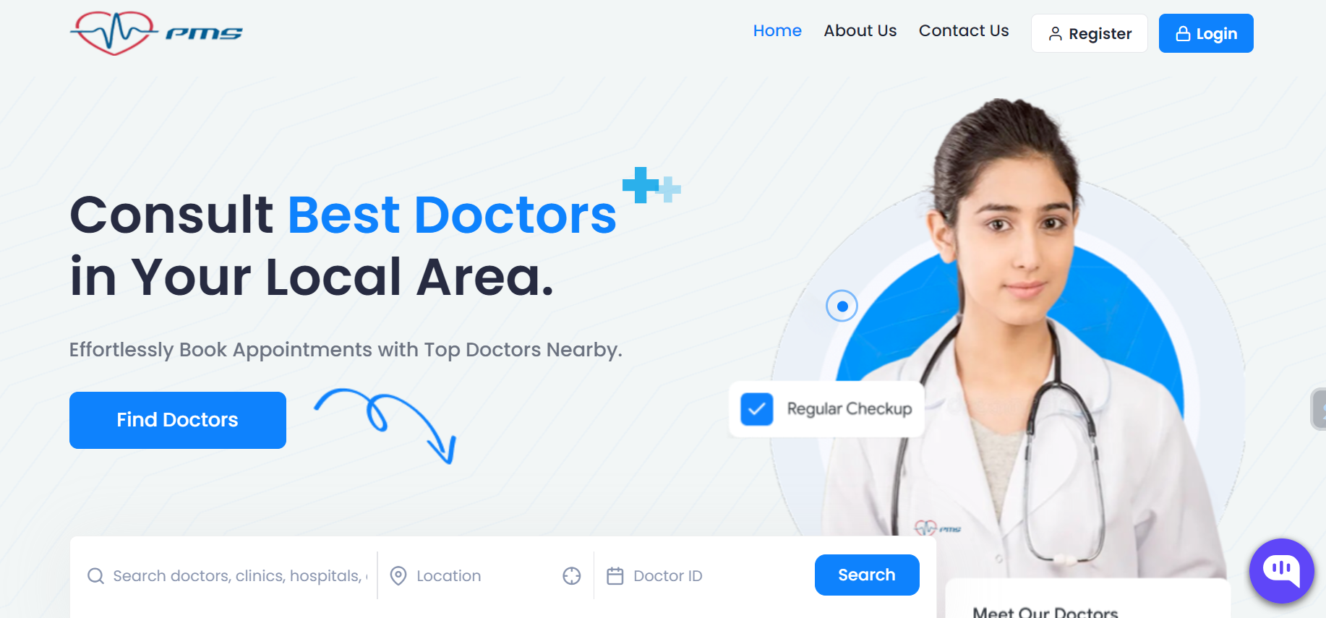
PROJECT WORK
1. Home Page

Slide 6
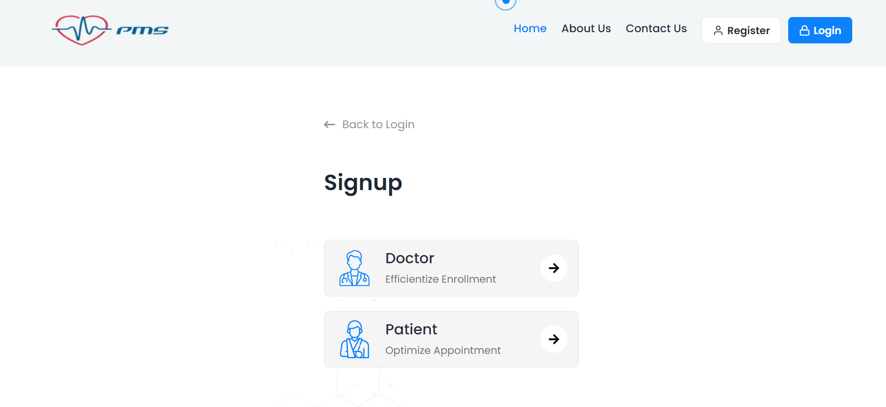
2. Login Page

Slide 7
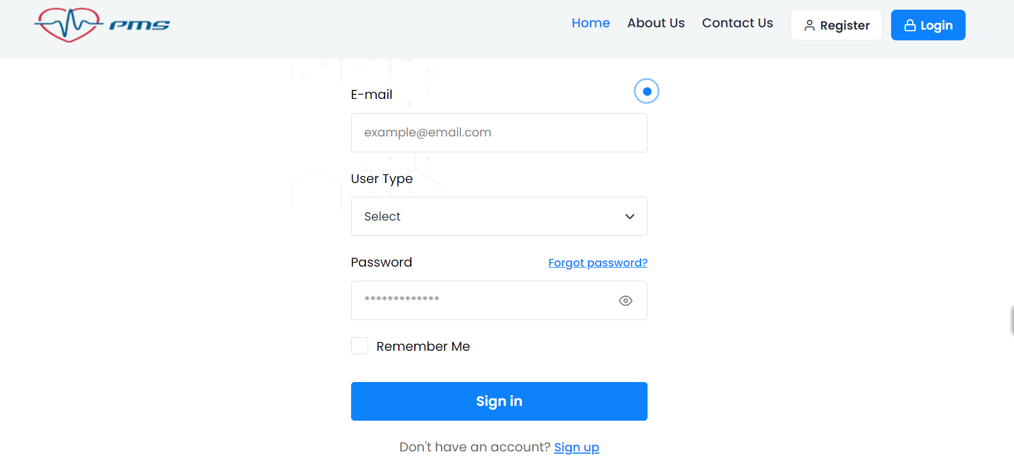
3. Doctor/Patient Register Page

Slide 8
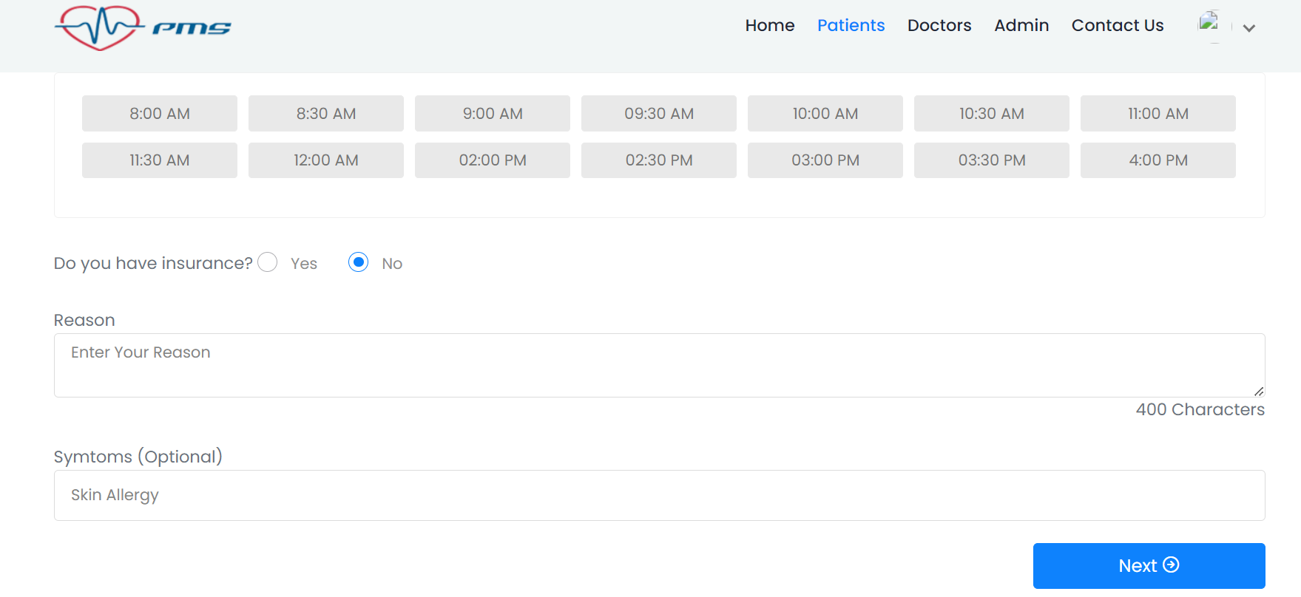
4. Patients Appointment Booking Page

Slide 9
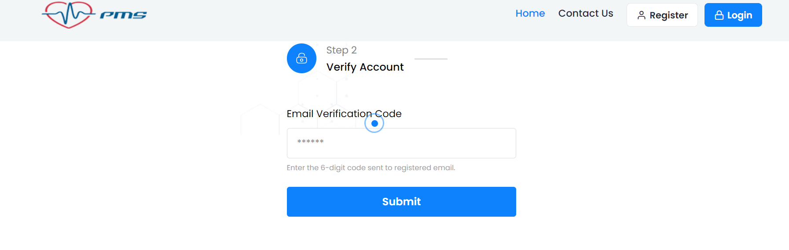
5. Verification Account Page

Slide 10
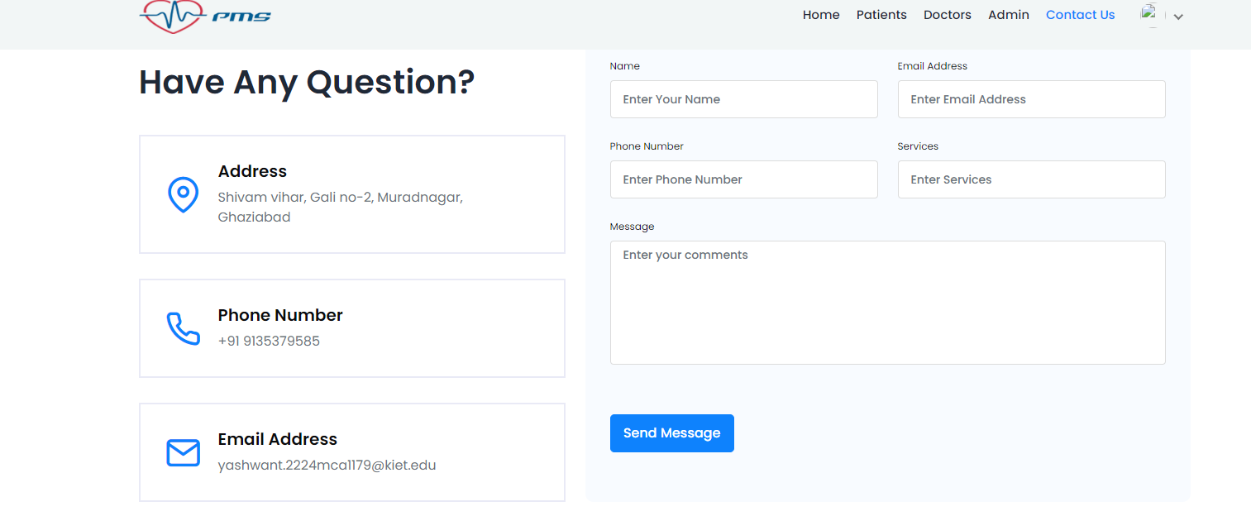
6. Contact us

Slide 11
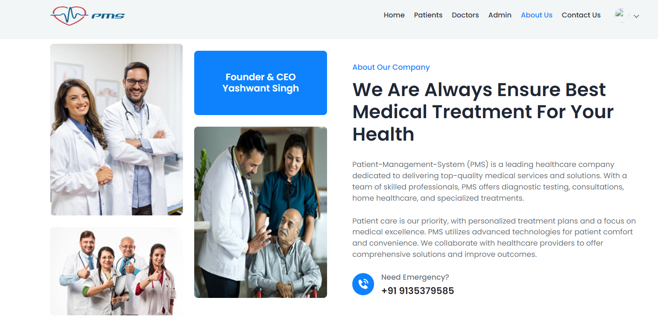
7.About us

Slide 12
conclusion
In conclusion, a patient management system streamlines healthcare operations, enhances patient care quality, improves efficiency, and facilitates better communication among healthcare providers. It ensures accurate record-keeping, enables timely access to patient information, and ultimately contributes to better healthcare outcomes.

Slide 13
Thank you

